Slide 1

SyBil-AA General Assembly Meeting Berlin – 06/09/2016
Building the matrix
WP6
 | Dr. Eng. Vasile Vlad Moca

Slide 2
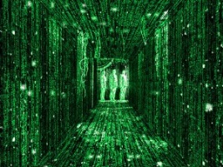
Contents
FMRI data
Resting state FMRI - methods
Building the matrix: functional connectivity
Data
Correlation/Scaled correlation
Adjacency matrices
Future: effective connectivity

Slide 3

FMRI
Slow and delayed signal:
Low sampling: TR = 2s, usually [0.5, 3]s
Hemodynamic responses last 10s
Integrates neural responses over time
Rise/fall multiplicatively – peak 4-6s
Noisy:
Heat, system noise, unrelated neural activity, variable behavior or mental strategies
Physiological noise:
head/brain movement
2/3 of the noise: variations in blood flow/volume, and oxygen use
s vs. ms

Slide 4
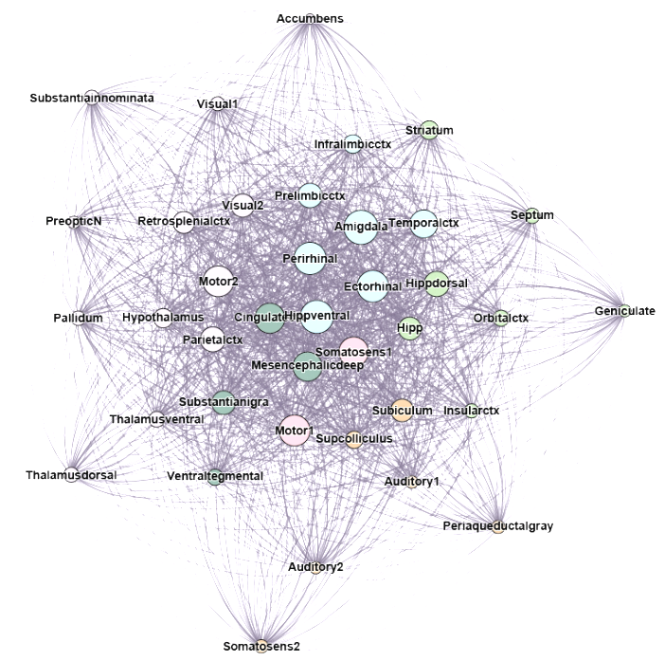
Resting state FMRI - methods
Spontaneous low freq. activity (< 0.1Hz)
Many classes of analysis methods:
seed-based (Region Of Interest)
independent component analysis,
clustering algorithms,
neural networks & pattern classifiers,
graph methods
Connectivity:
Anatomical (structural)
Functional (statistics)
Effective (causal interactions)
Show similar properties in healthy humans

Slide 5
Building the matrix - data
38 areas
17 animals (rat)
1 trial: 90 samples – 180s
Control: 85 trials
EtOH: 85 trials
Abstinence: 40 trials
Naltrexone: 45 trials
All channels all trials
DC removed
Low pass 0.1 Hz
Average reference
CCF
CCF
CCF
ACF
ACF
ACF
High freq. noise
Common noise

Slide 6
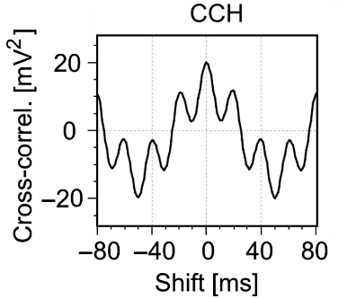
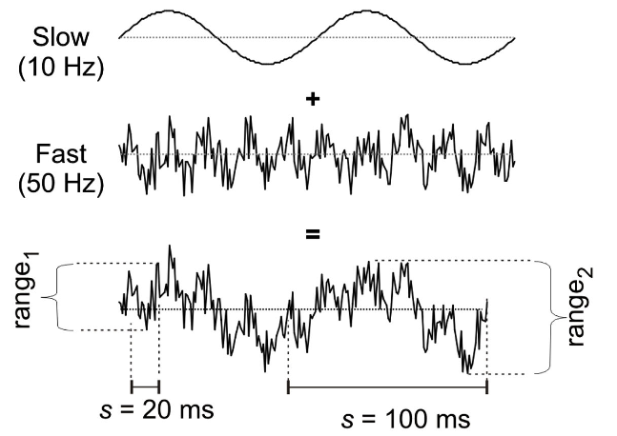
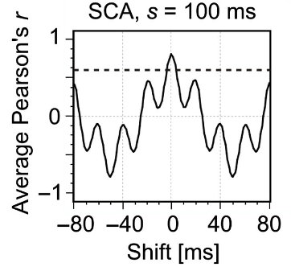
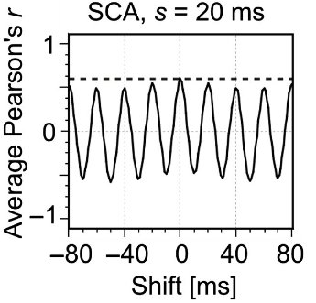
Scaled correlation
Two signals composed of slow & fast
Depending on the scale, scaled correlation can isolate faster components.
CCF
Long scale
Short scale
Nikolić D, Muresan RC, Feng W, Singer W (2012) Scaled correlation analysis: a better way to compute a cross-correlogram. European Journal of Neuroscience, pp. 1–21

Slide 7
Scaled correlation
Hipp., all trials
Somatosens1 – Prelibmicctx, Control
ACF
SCA
Value
SCA scale s=10s
Delay

Slide 8
Adjacency matrices - global
Value
Delay

Slide 9
Adjacency matrices - Control

Slide 10
Adjacency matrices - EtOH

Slide 11
Adjacency matrices – Abst.

Slide 12
Adjacency matrices – Naltrex.

Slide 13
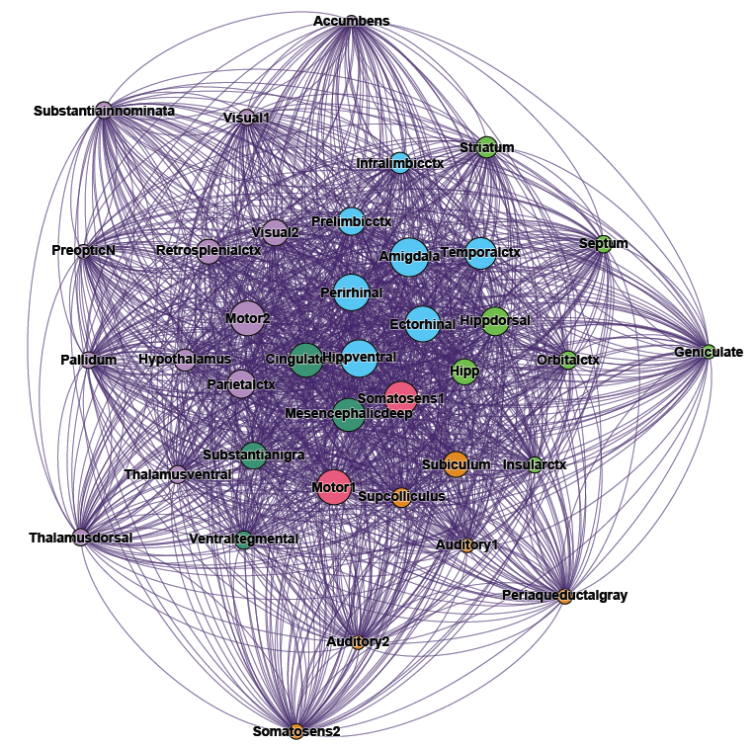
Future?
Future: effective connectivity
Transfer entropy
Granger causality
…
Can we get more data?
Longer FMRI traces?
Electrophysiology?
Human EEG, FMRI?
Longer term evolution of alcohol addiction?

